Slide 1


Tuesday
-
Saral Admin
-
2025-02-25
Saral
Admin
Presented by Aryan Adhikari

Slide 2

2025-02-25
Introduction
-
An admin dashboard focused on business efficiency.
Inter company management system that focuses on efficiency and company’s success.
01
Clients, Projects, Tasks management and real-time data visualization.
Saral Admin

Slide 3
2025-02-25
Problem Statement
-
Inability to monitor real time state of the company.
Lack of simple yet effective inter company management tools.
02
Lack of centralized system for managing and analyzing company’s data.
Saral Admin

Slide 4
01.
Provide powerful inter company data analysis tool.
Objectives
02.
Facilitate easy access and analysis of business data.
03
03.
Provide data visualization through charts and graphs.

Slide 5
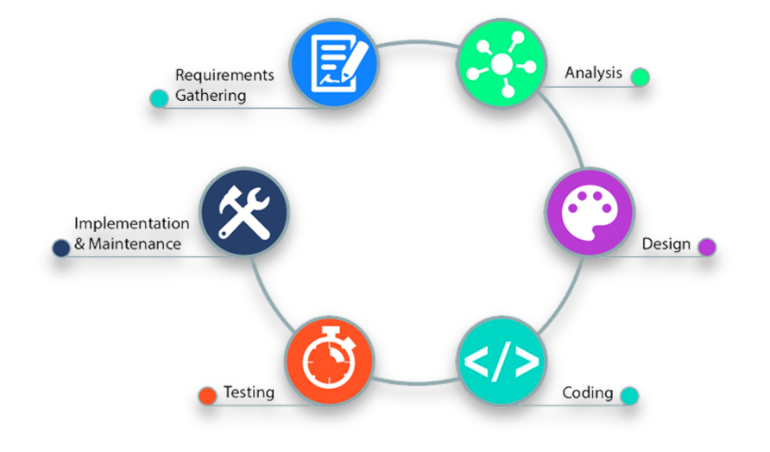
Saral Admin
-
2025-02-25
Methodology
04

Slide 6
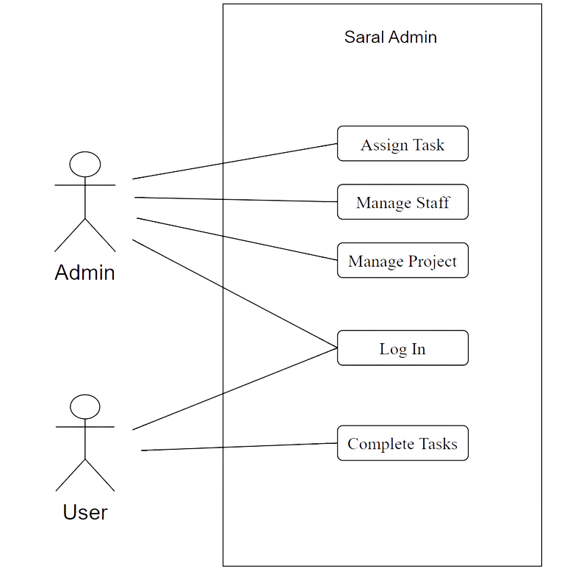
Use-Case
Diagram
2025-02-25
-
05
Saral Admin

Slide 7
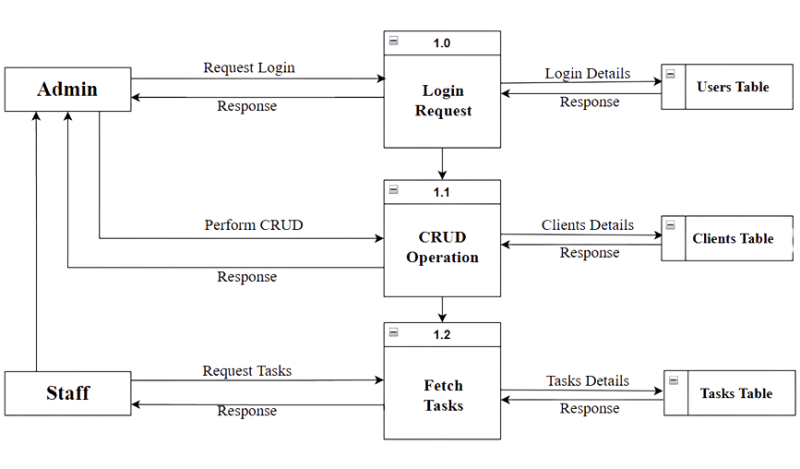

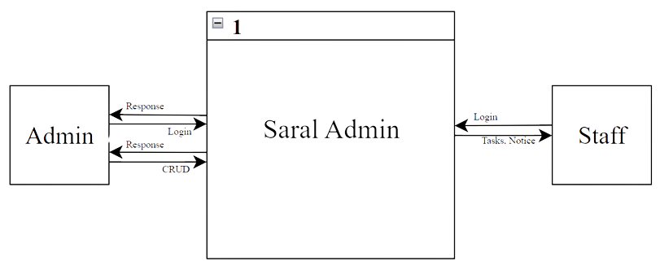

06
DFD
Data Flow Diagram
DFD Level 1
DFD Level 0
Tuesday
-
Saral Admin
-
2025-02-25

Slide 8


Tools Used
Key Features
Frontend
01
React
01
Role based access
TailwindCSS
Typescript
Backend
02
Implementation
02
Node.js
Realtime Dashboard
Express.js
of Saral Admin
Database
07
03
03
MySQL
Task Management

Slide 9
08
Results
A fully functional admin dashboard with real-time data monitoring.
Result &
Conclusion
Role based access in the system ensuring data security.
Conclusion
As i concluded this project’s development, i realized there are a few features that could significantly enhance the project in the future:
A kanban board instead of traditional table for task management.
Real time notification and email for task completion.

Slide 10
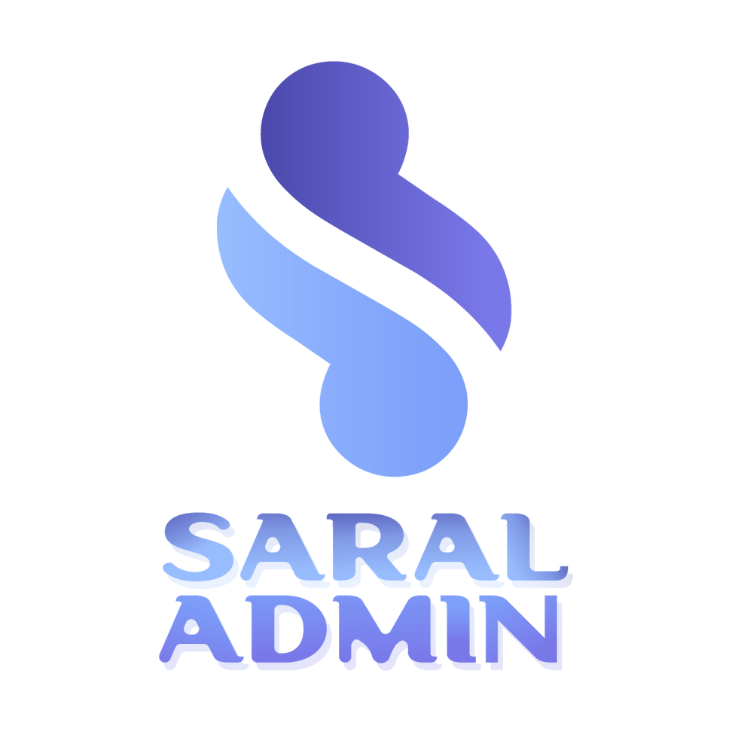
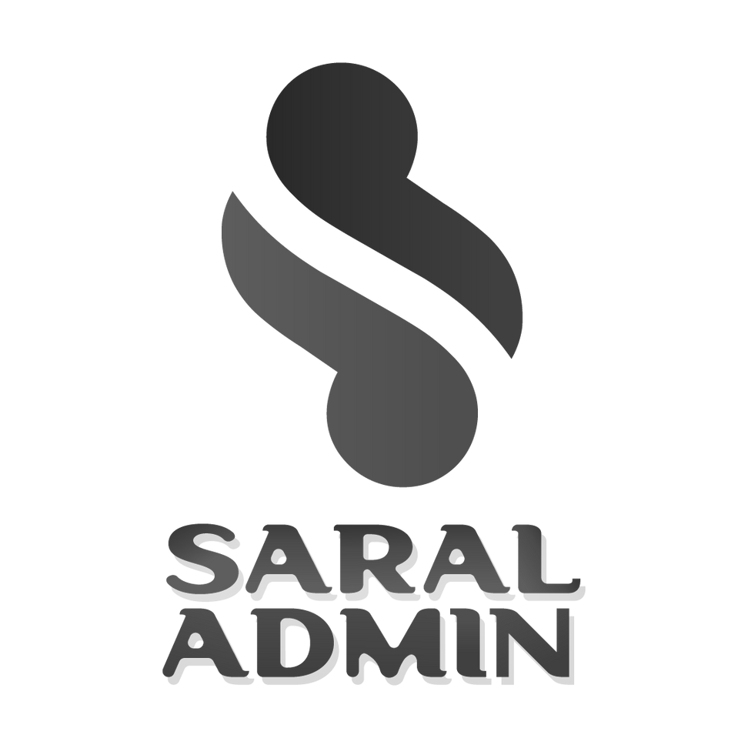

Any Questions?

Slide 11
Tuesday
-
Saral Admin
-
2025-02-25
Thank You!

